Slide 1
Methodological Advances in Statistical Population Genetics
Eric C. Anderson
SWFSC
Southwest Fisheries Science Center
Fisheries Ecology Division

Slide 2
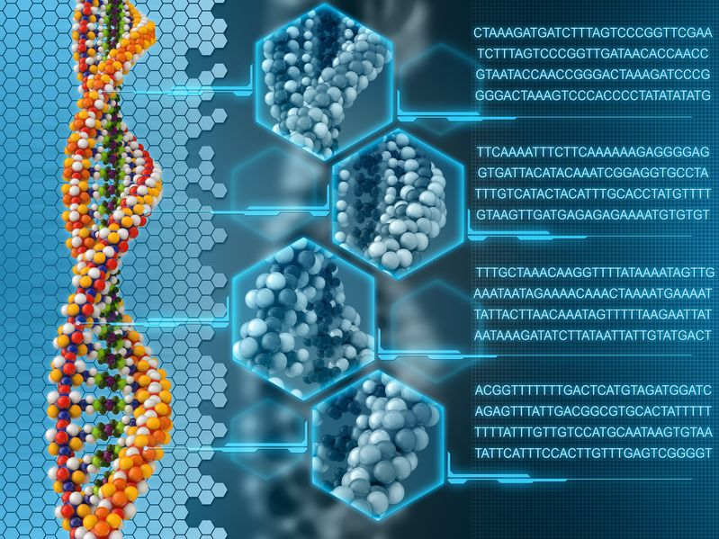

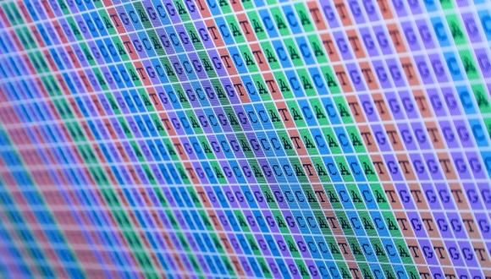
Extraordinary advances in genetic technology
bioplatforms.com
http://www.bioplatforms.com/
stcorp.no
tau.ac.il

Slide 3
Highlights of three statistical genetic problems
Pedigree Reconstruction
Close-Kin Mark-Recapture
Keeping People Honest

Slide 4
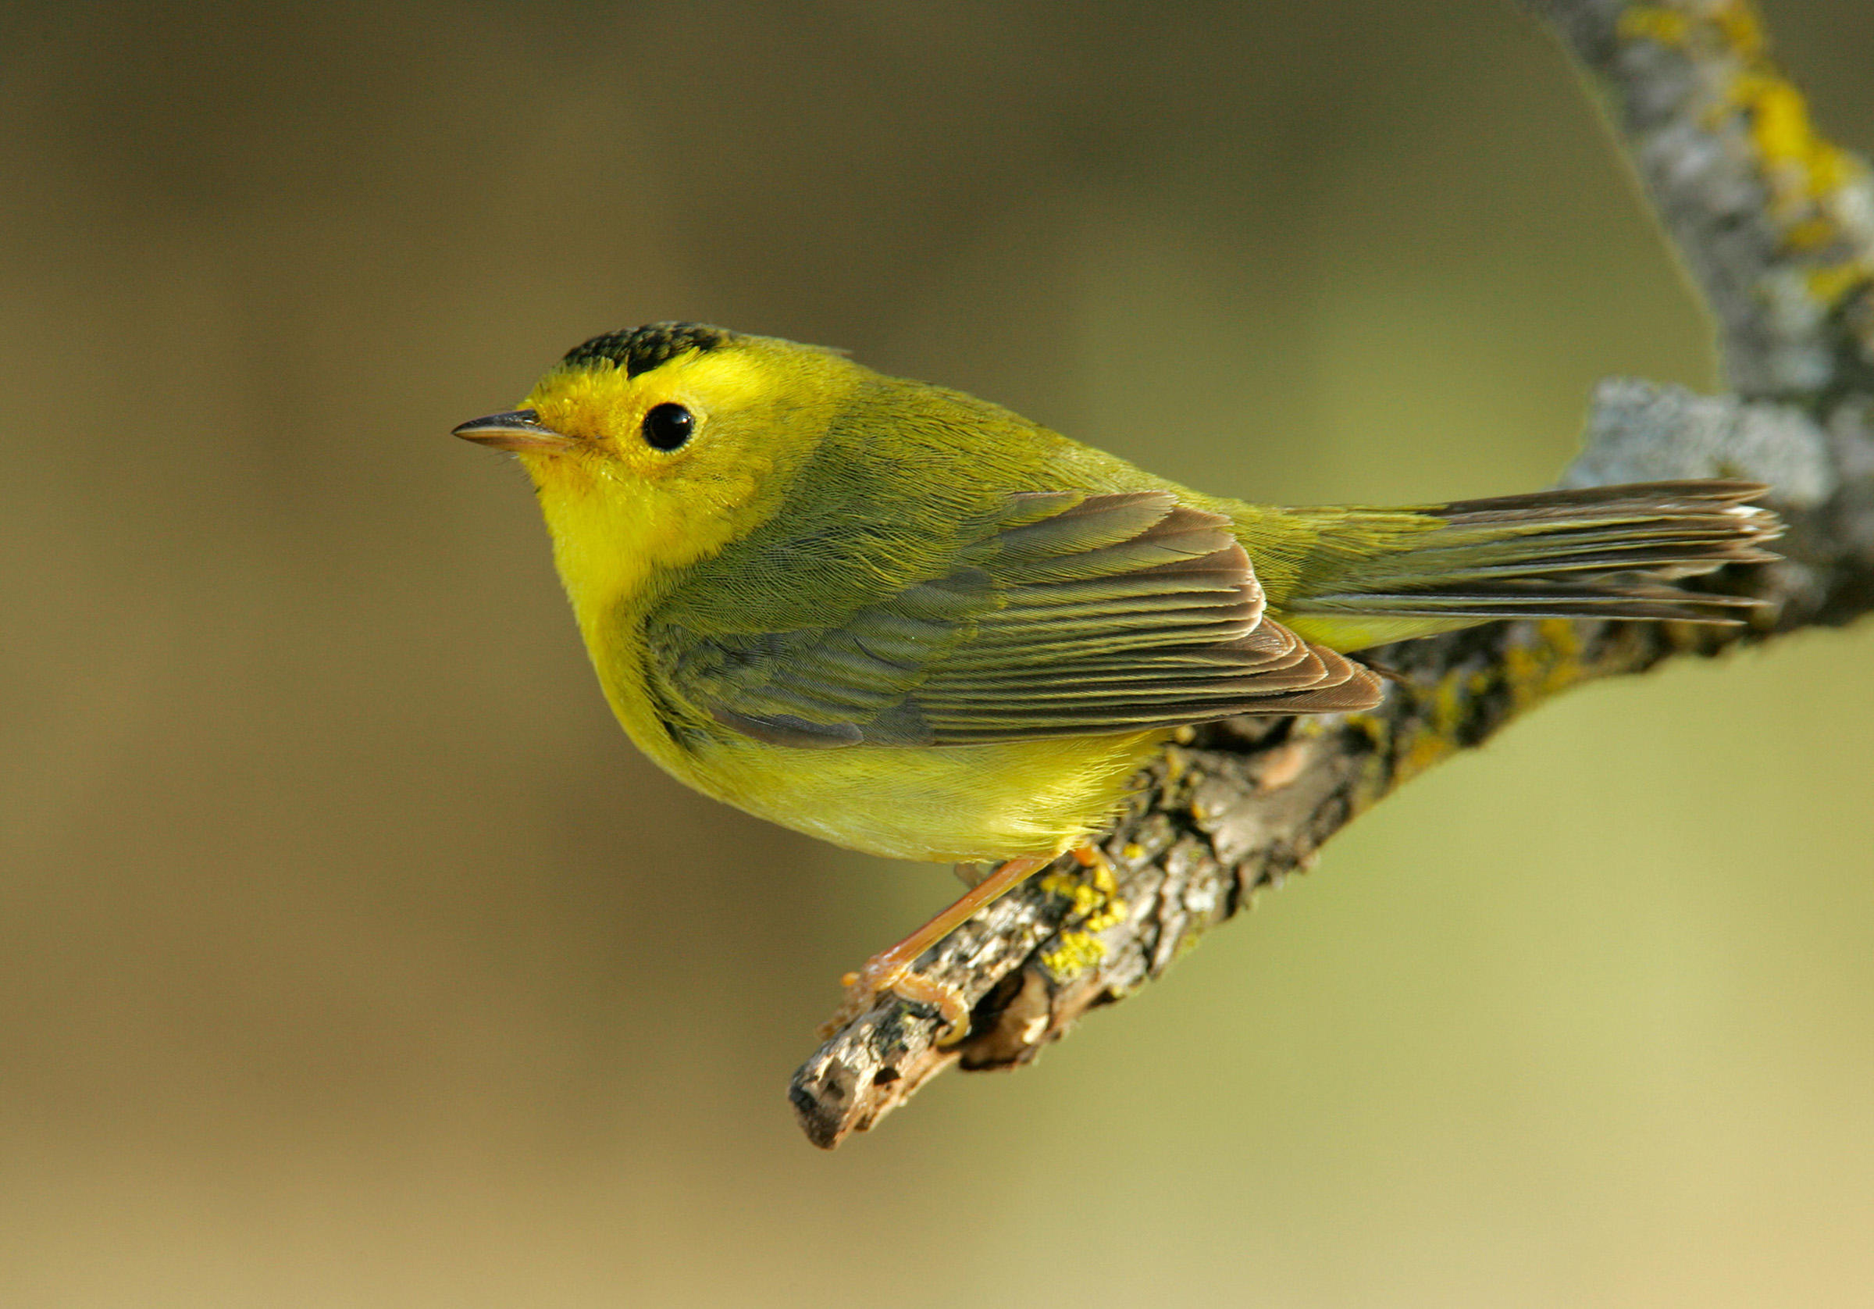
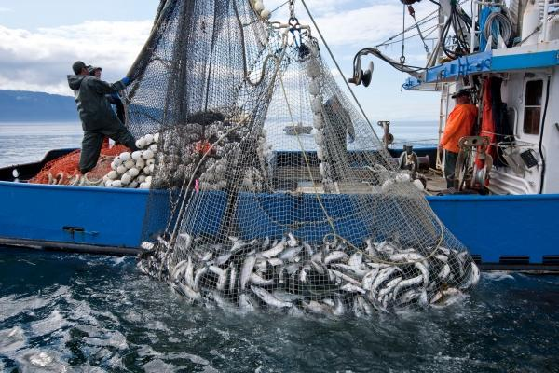
Applications to Fisheries Management and Animal Conservation
http://juneauempire.com/
audubon.org

Slide 5
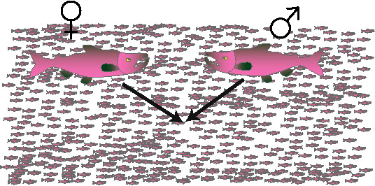
Inferring Pedigrees: an extension of parentage inference

Slide 6
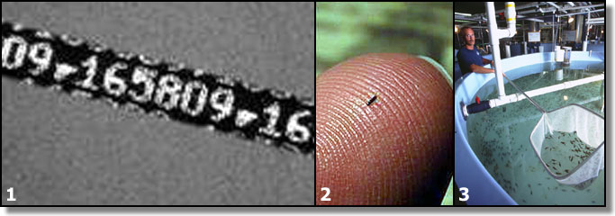
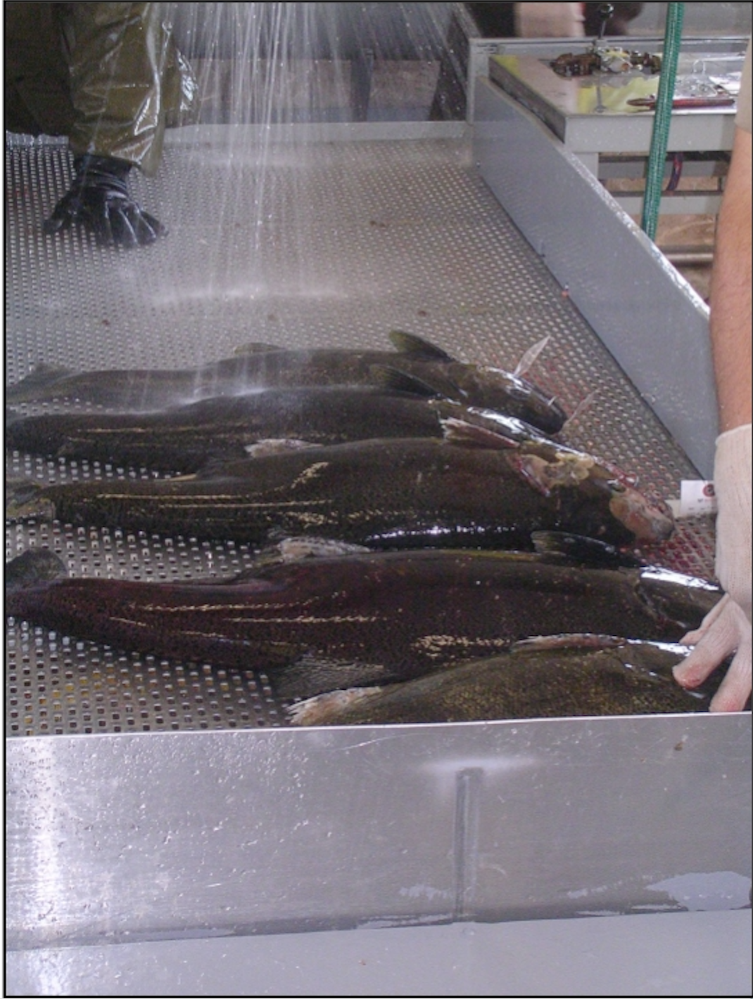



We developed Parentage Based Tagging…
www.wildlife.ca.gov

Slide 7
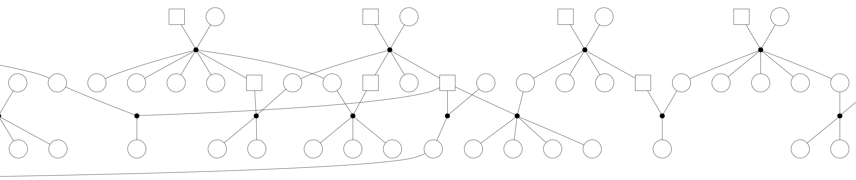
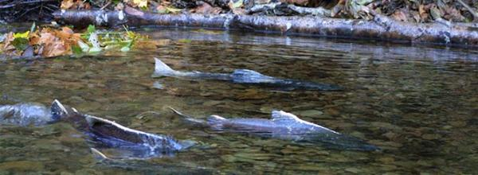
….but reconstructing multigenerational pedigrees in wild populations is much harder.
usfws.gov

Slide 8
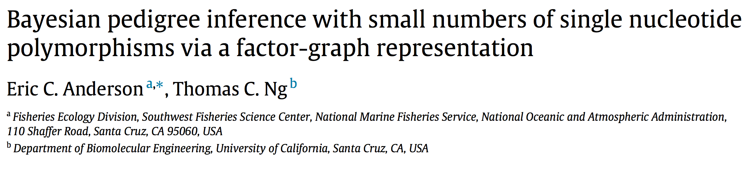
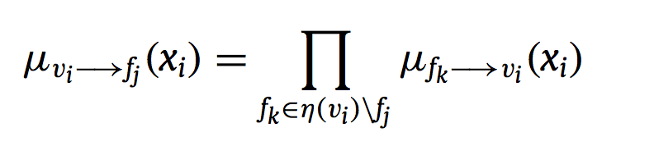
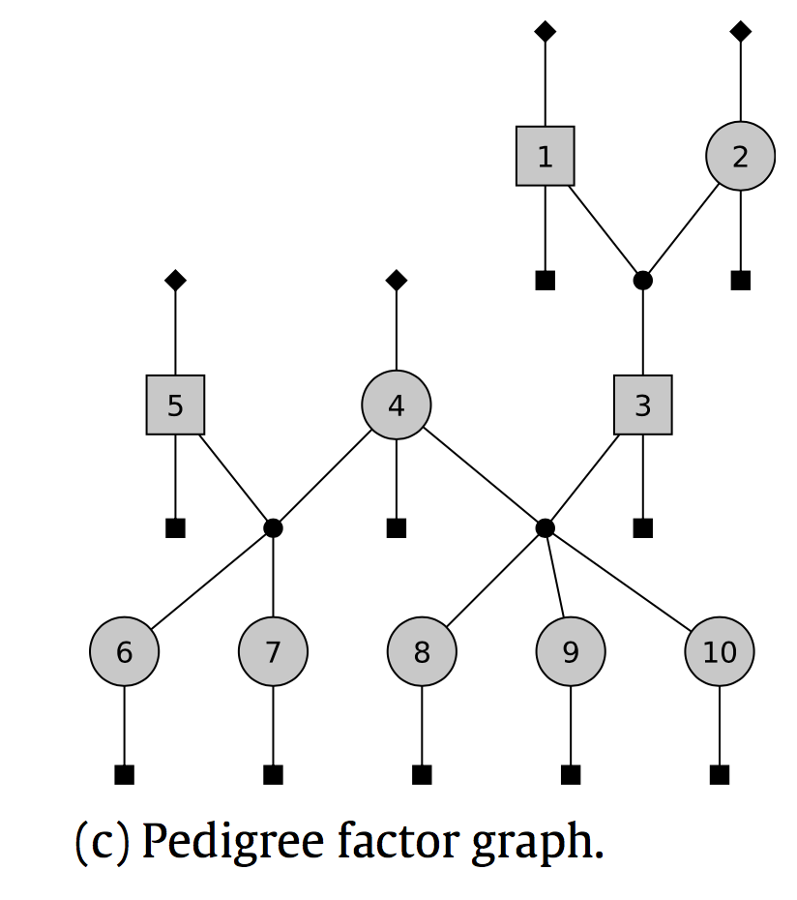
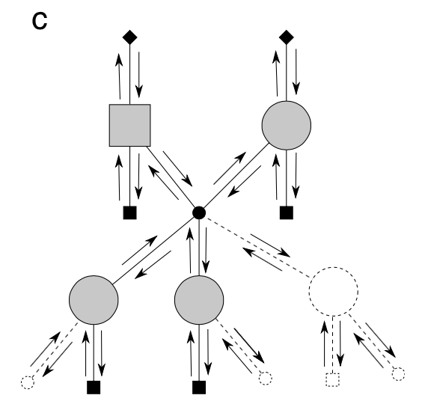
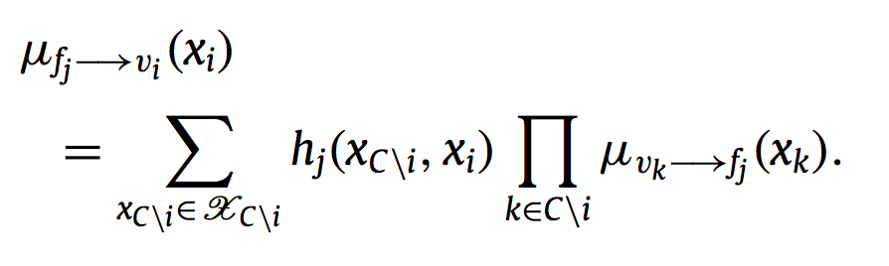
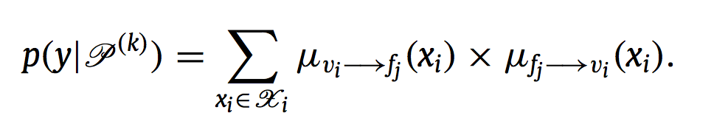

Slide 9
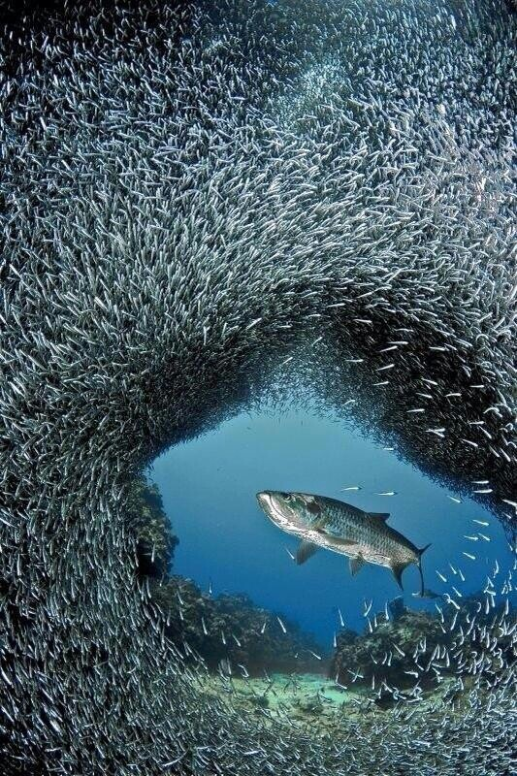
Inferring Relationships in Large, Sparsely-sampled populations
When only a small fraction of the population is sampled, related pairs are few and far between.
Joint inference between them all is unnecessary…

Slide 10
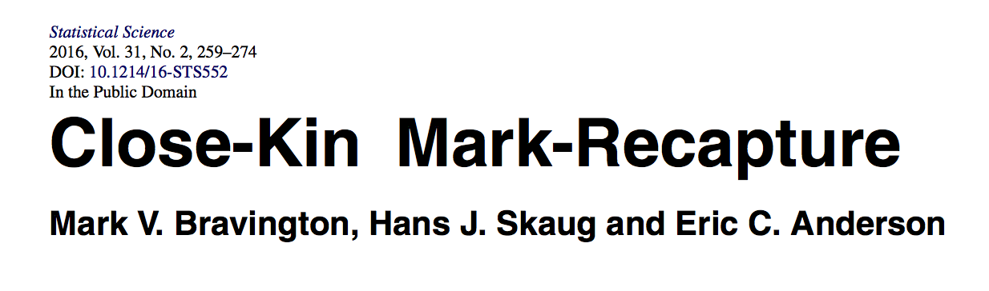
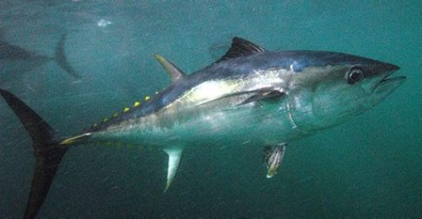
http://www.dpi.nsw.gov.au/
Genetically-identified kin-pairs (parents, siblings, etc.) can be treated as a type of “recapture.”

Slide 11
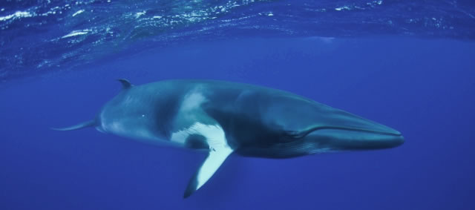
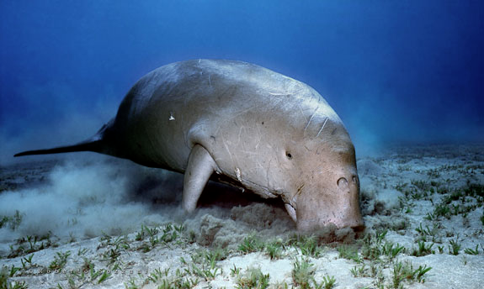
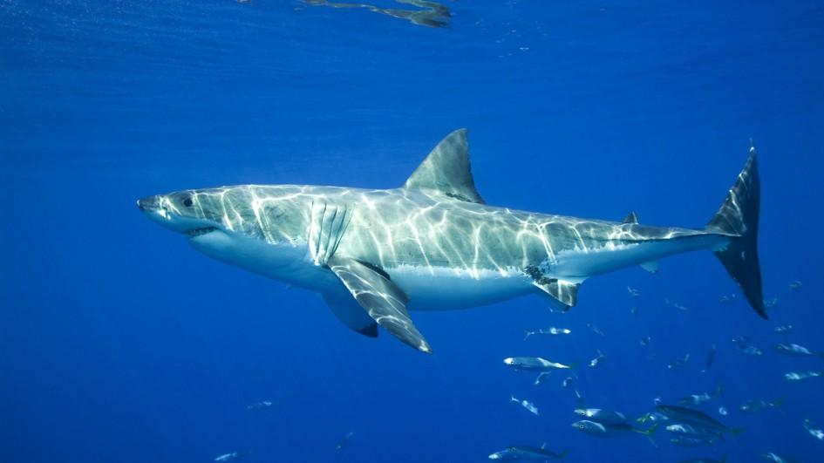
Applications of Close-Kin Mark-Recapture
http://www.whale-watching-alaska.com/
http://www.dpi.nsw.gov.au/
nationalgeographic.com/
http://www.australiansforanimals.org.au/

Slide 12
CKMRsim An R package for Close-Kin Mark-Recapture
Efficient estimation of tiny false positive rates
Models for most data types
Simulation of physically linked markers
Available on GitHub

Slide 13
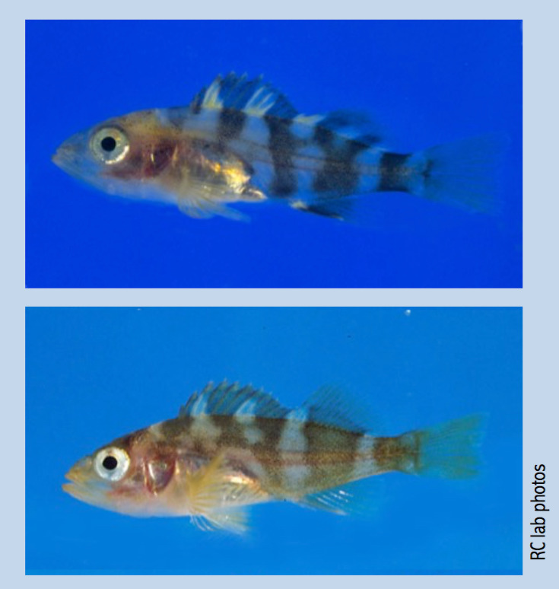
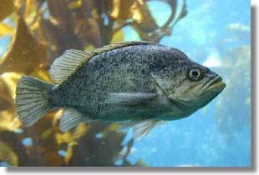
CKMRsim on Rockfish Microhaplotypes. 15,000 Fish and Counting…
wikimedia.org

Slide 14
The Importance of Being Honest: How much better is that new genetic data going to be? There are many ways to inadvertently get that question wrong.

Slide 15
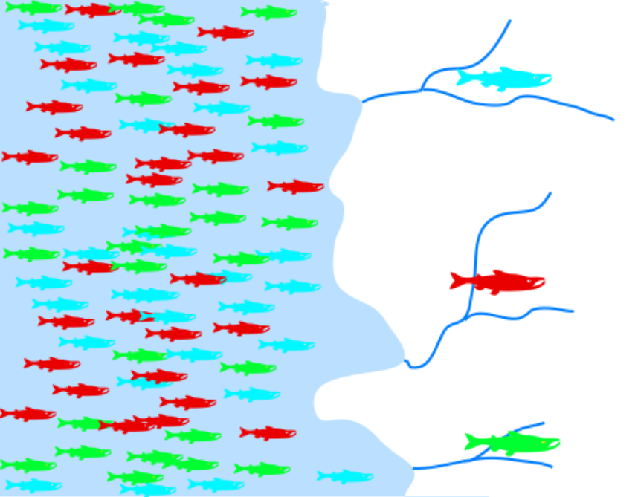
Example: Genetic Stock Identification
Use genetic markers to identify the population-of-origin of ocean-caught fish.

Slide 16
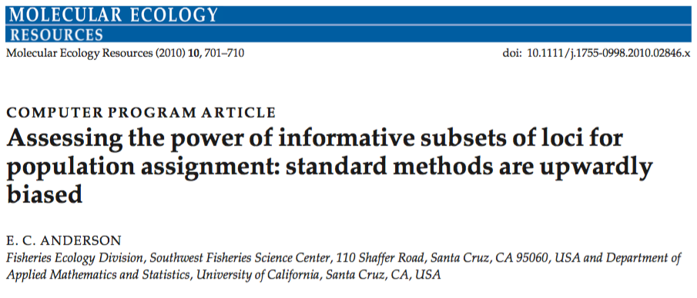

Slide 17
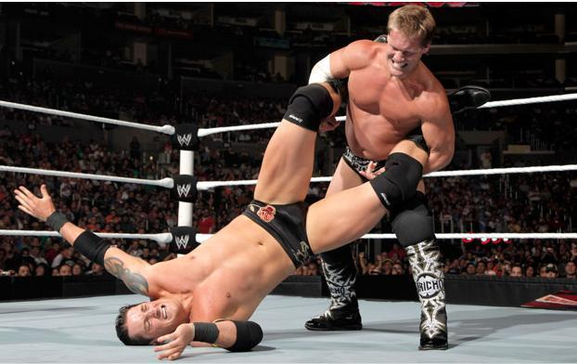
Next time, use a proper cross- validation method!!
wrestingnewsworld.com

Slide 18

Good Morning. Can everyone say,
“High-grading bias?”
salon.com

Slide 19
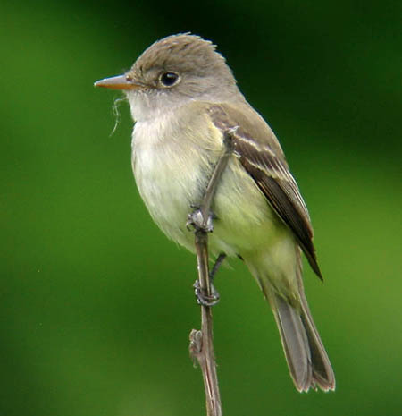
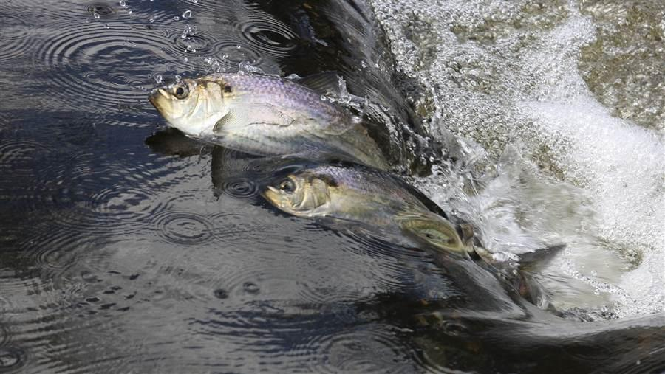
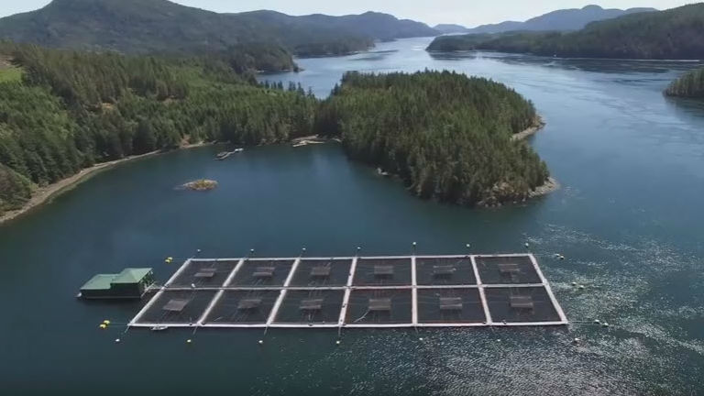
Software and methods widely applied
drakehs.org
pewtrusts.org
http://maritime-executive.com/

Slide 20
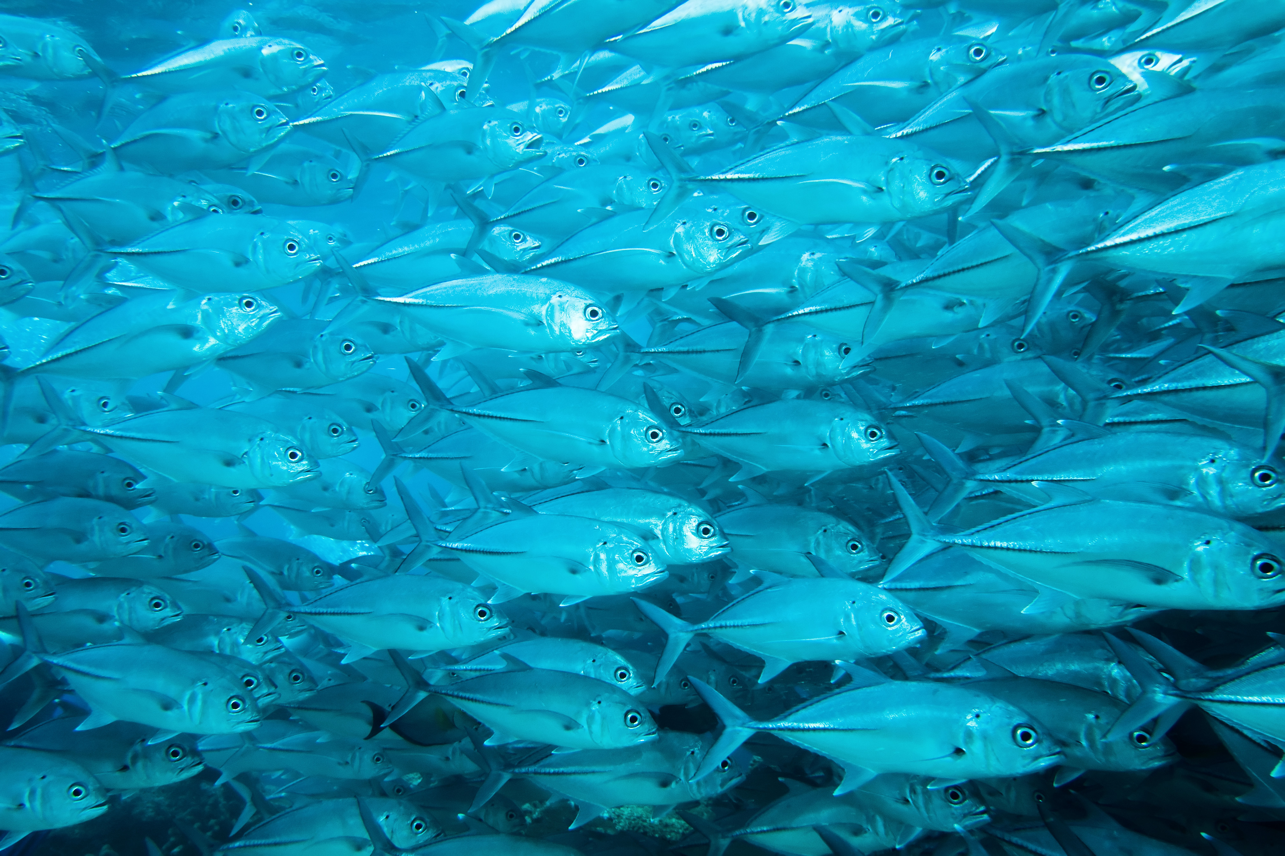
More Information
Google Scholar Search: “Eric C Anderson”
github.com/eriqande

